Slide 1
CEG5304 / EE6934 (PT2)
Lecture 9:
Basics and Advances of Graph Neural Network, with Guest Lecture from Dr. Tianze Luo

Slide 2
Admin Issues for Week 9: CA#2
Topic: same for CEG5304 and EE6934: image generation with diffusion-based method.
Format: exploratory “essay”, no coding required. Marks given according to the “description” and “discussion”.
I.e., a more detailed “description” and “discussion” is the key to higher marks.
New deadline: 20 Apr 2024 1759 SGT. Please hand in on time.

Slide 3
Admin Issues for Week 9: Syllabus Change
Minor syllabus change for Week 10, 11 and 12.
The topics of Week 10, 11, and 12 will swap (Week 10 → 12):
New Week 10 topic: Video understanding and 3D understanding:
New Week 11 topic: Few-shot learning and transfer learning.
New Week 12 topic: Introduction to Bayesian Neural Networks (BNNs):
New syllabus will be updated in Canvas.

Slide 4
Graphs and Graph Neural Networks: The Basics
Graphs and its Related Concepts
Application of Graph Representation Learning
GNNs and GCNs

Slide 5
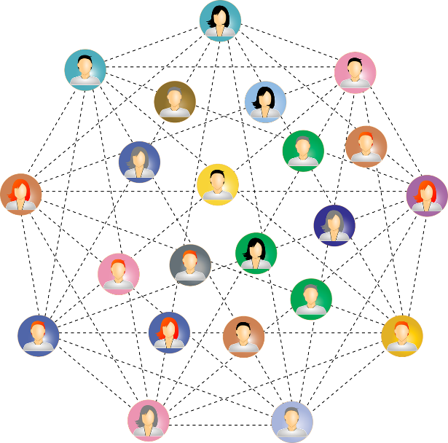

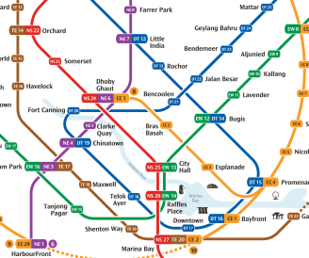
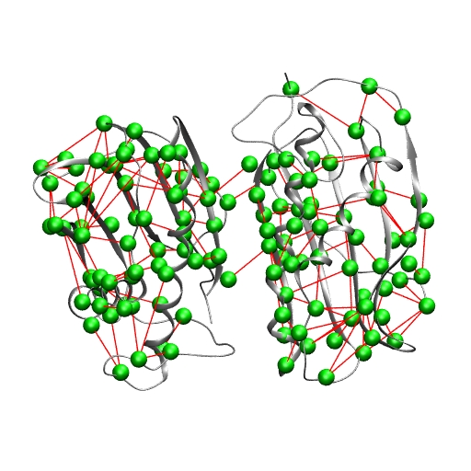
Graph: the Fundamental Part of GNN
What are graphs and why do we need Graphs?
Graphs are a general language for describing and analyzing entities with relations/interactions.
Graphs are ubiquitous:
Social networks
Computer Networks
MRT Networks
Proteins

Slide 6
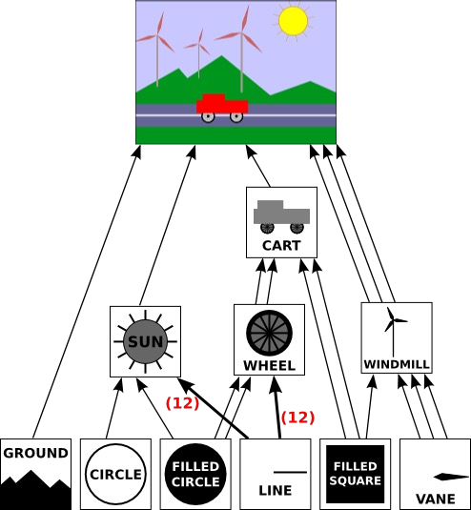
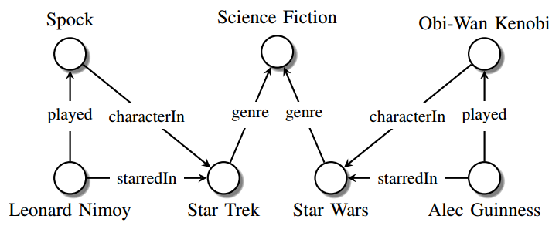
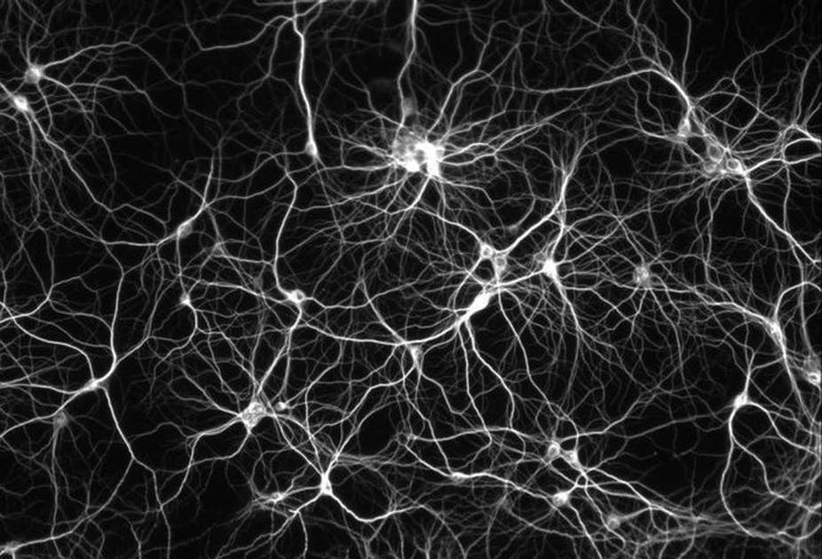
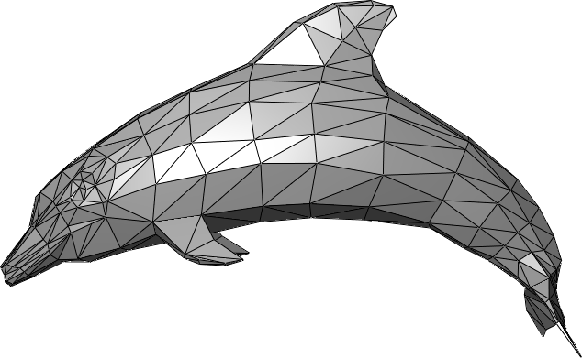
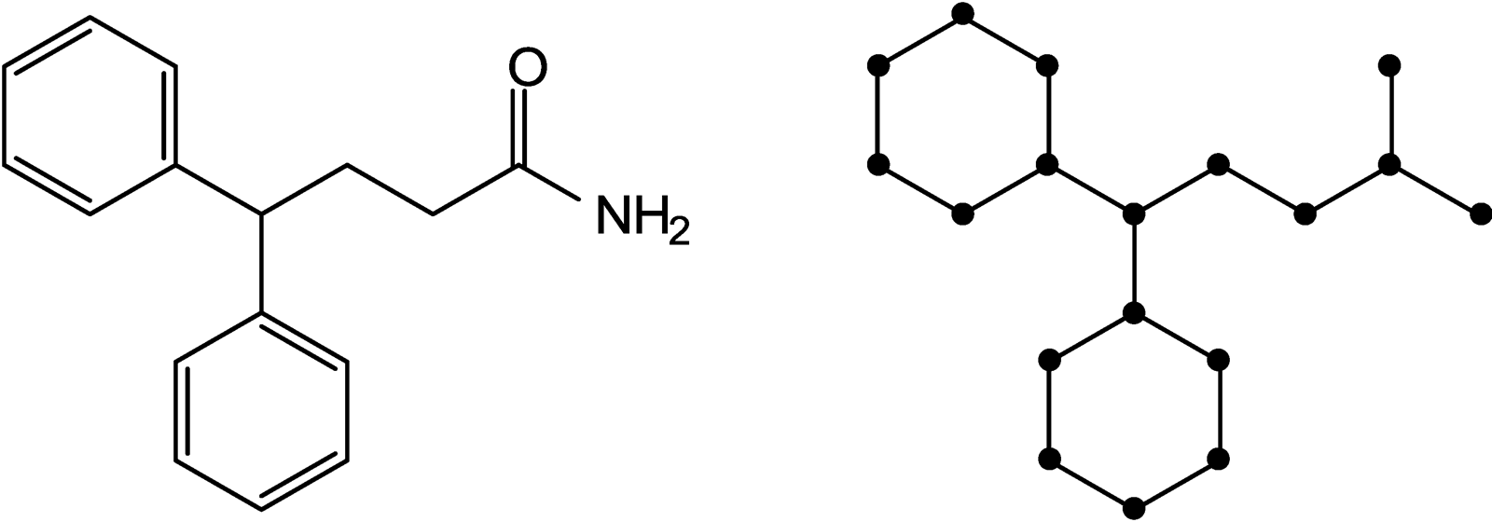
Examples of Data that are Graphs
Knowledge Graphs
Networks of Neurons
Scene Graphs
3D Shapes
Molecules

Slide 7
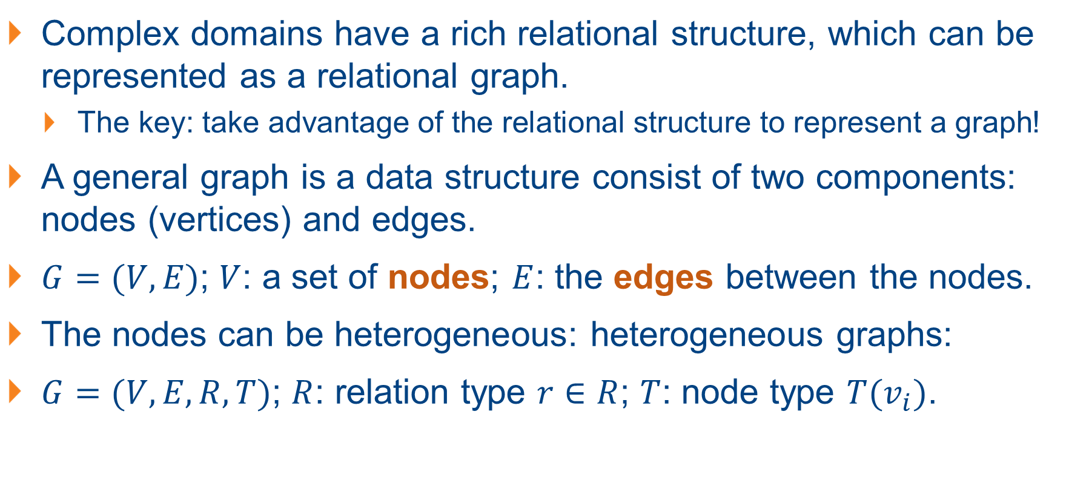
Graph Representation: Defining a Graph
Complex domains have a rich relational structure, which can be represented as a relational graph.
The key: take advantage of the relational structure to represent a graph!
A general graph is a data structure consist of two components: nodes (vertices) and edges.
$G=(V,E)$; $V$: a set of nodes; $E$: the edges between the nodes.
The nodes can be heterogeneous: heterogeneous graphs:
$G=(V, E, R, T)$; $R$: relation type $r∈R$; $T$: node type $T(v_{i})$.

Slide 8
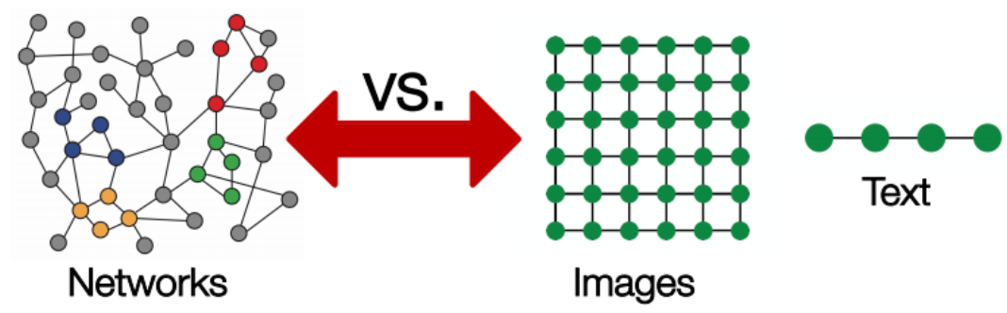
Graph Representation: Challenges
Graphs / Networks are complex: arbitrary size and complex topological structure (i.e., no spatial locality like grids).
No fixed node ordering or reference point.
Often dynamic and have multimodal features (heterogenous graphs are common).

Slide 9
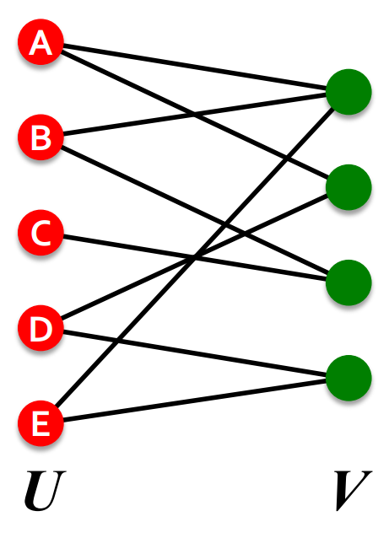
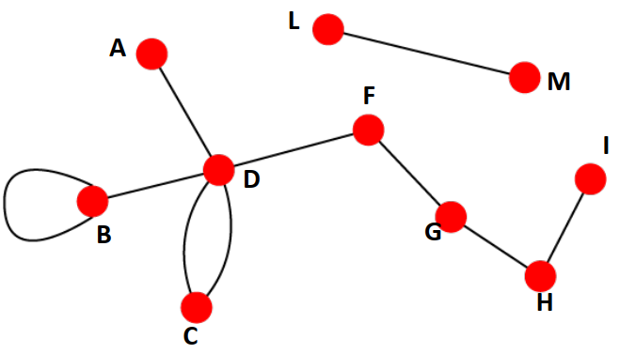
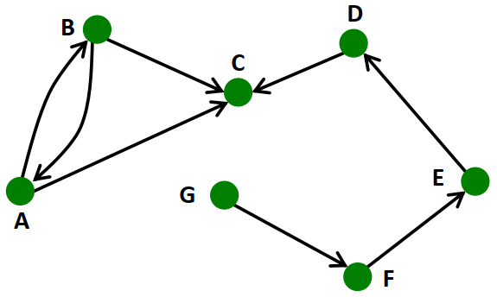
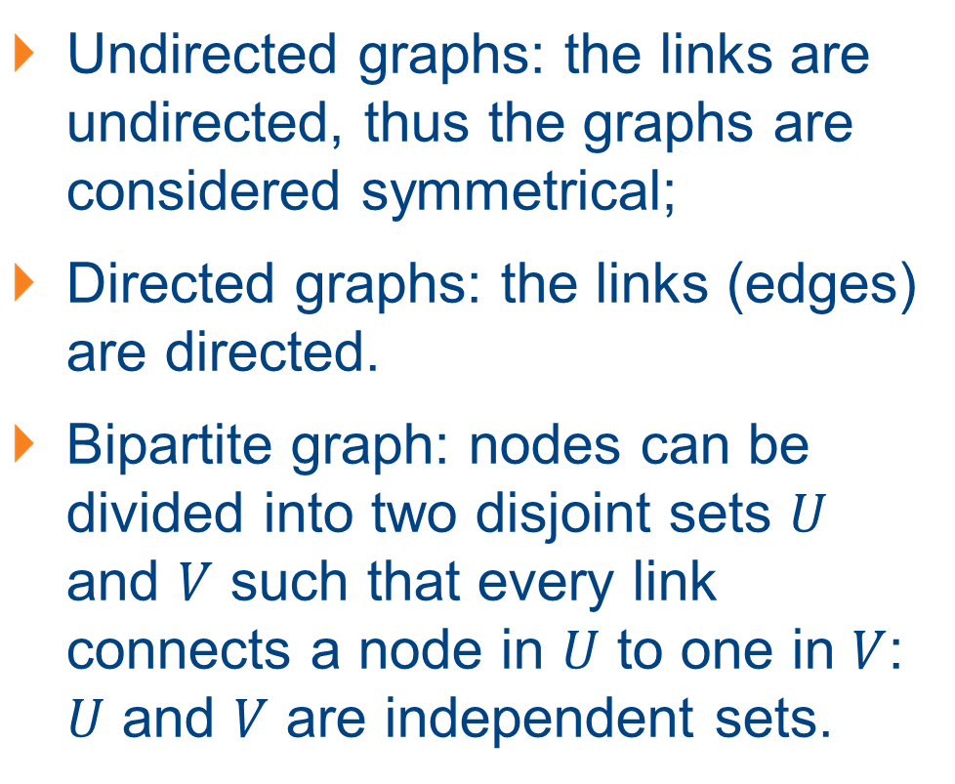
Common Types of Graphs
Undirected graphs: the links are undirected, thus the graphs are considered symmetrical;
Directed graphs: the links (edges) are directed.
Bipartite graph: nodes can be divided into two disjoint sets $U$ and $V$ such that every link connects a node in $U$ to one in $V$: $U$ and $V$ are independent sets.

Slide 10
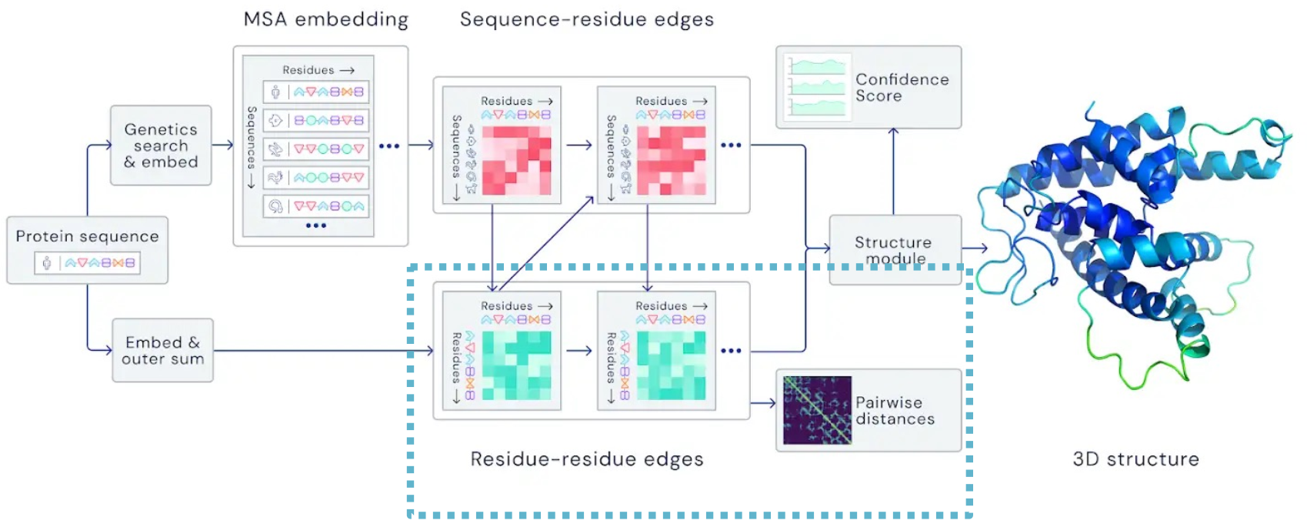
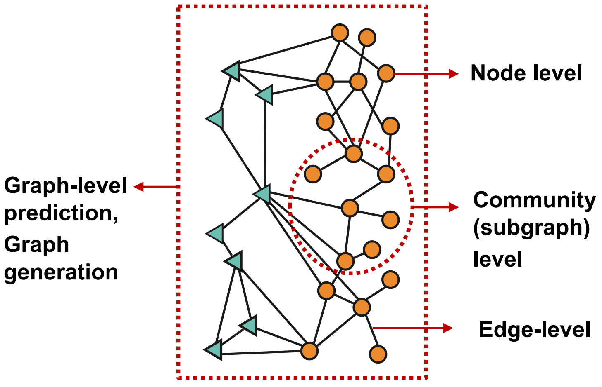
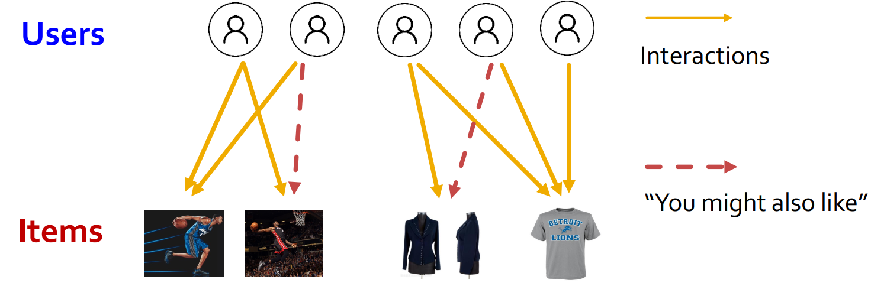
Graph Tasks of Different Levels
Node level: characterize the structure and position of a node in the network.
Protein folding – Predict protein’s 3D structure based on its amino acid sequence.
AlphaFold: Nodes: the amino acids in a protein sequence; Edges: the proximity btw amino acids.
Edge level: predict new edges based on existing edges.
Recommender systems.
Drug side effects: given a pair of drugs, predict adverse side effects.
Notes:
Protein folding: for each node predict its 3D coord.
Green: experimental results
Blue: Computational prediction
AlphaFold: AI4Science

Slide 11
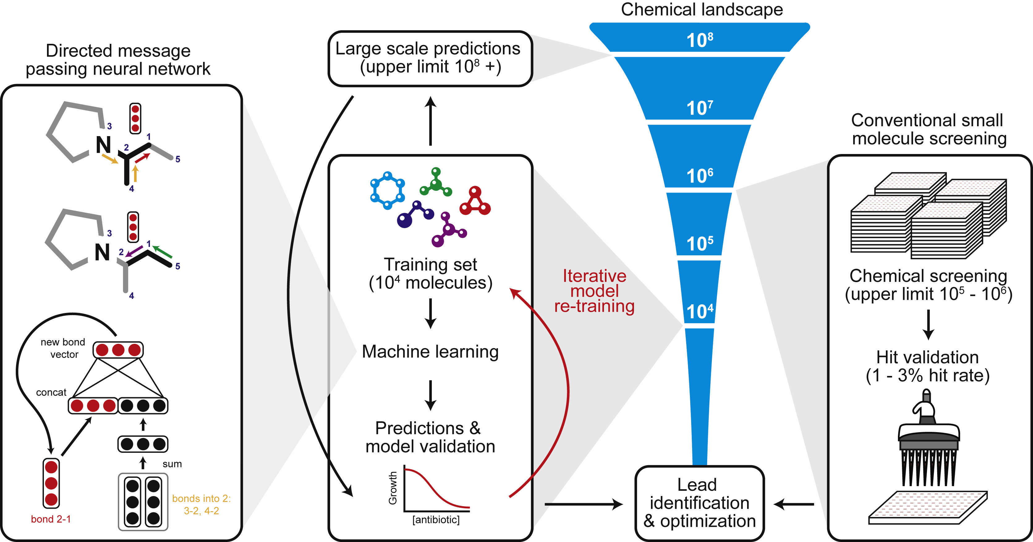
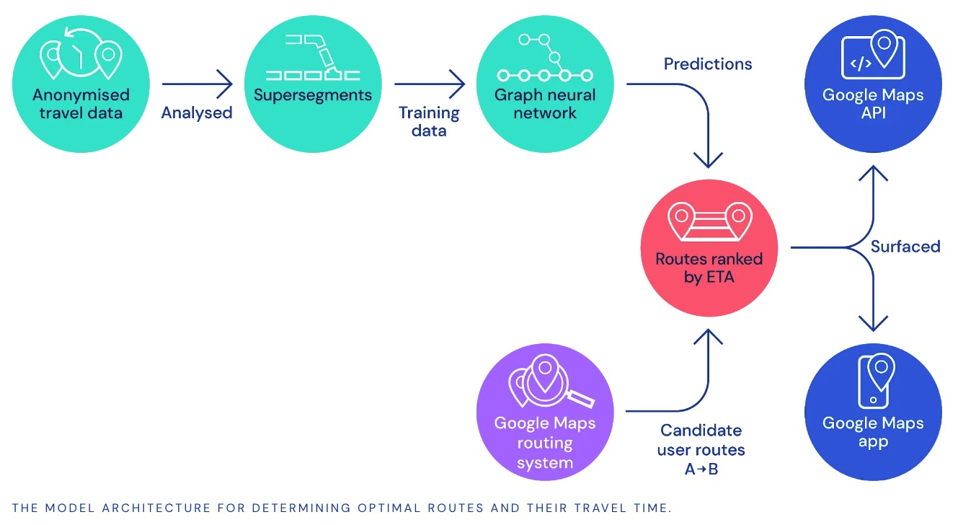
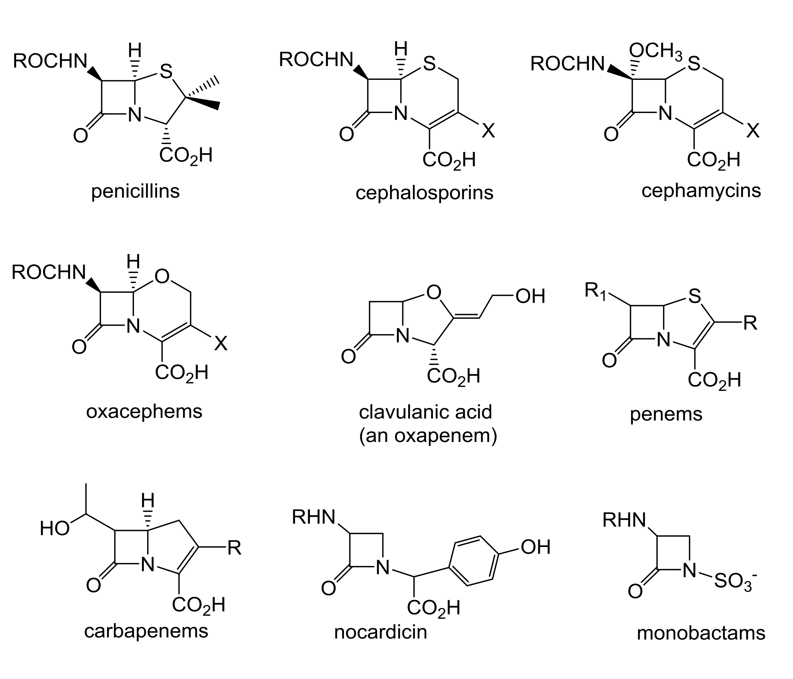
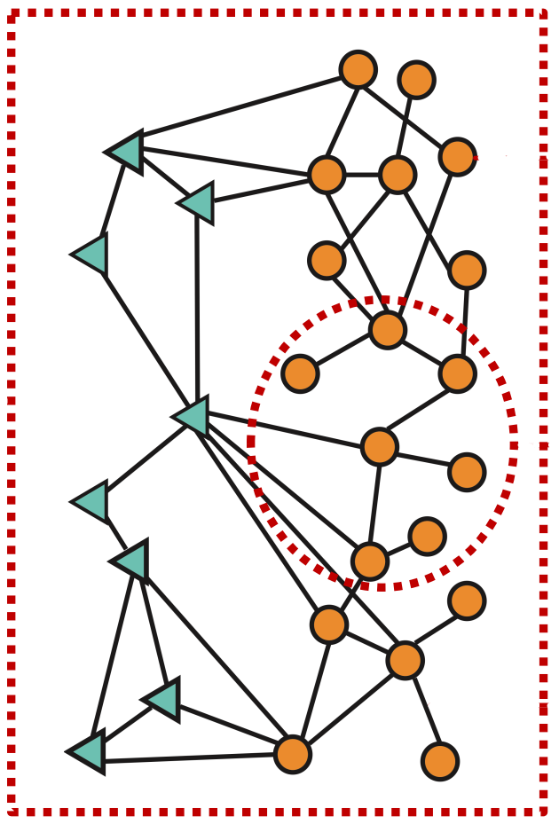
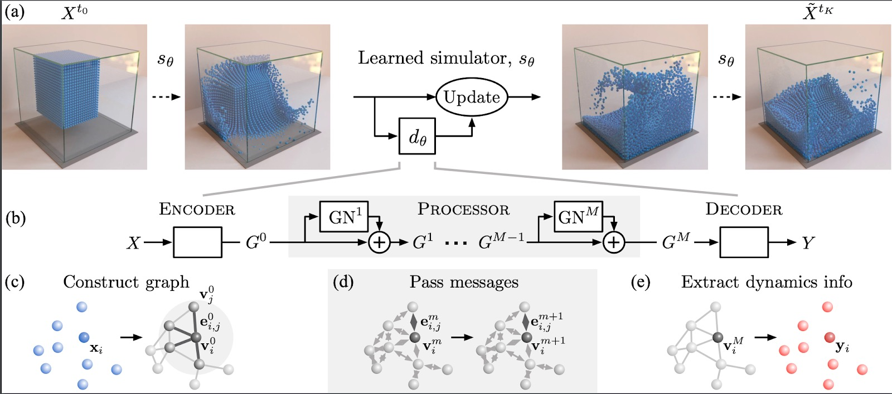
Graph Tasks of Different Levels
Graph level: prediction of entire graph or a sub-graph of the graph.
Traffic prediction: predict the time of arrival (ETA) with Google Map – nodes: road segments; edges: connectivity between road segments.
Drug discovery: nodes: atoms; edges: chemical bonds.
Physics simulation: nodes: particles; edges: interaction between all particles.

Slide 12
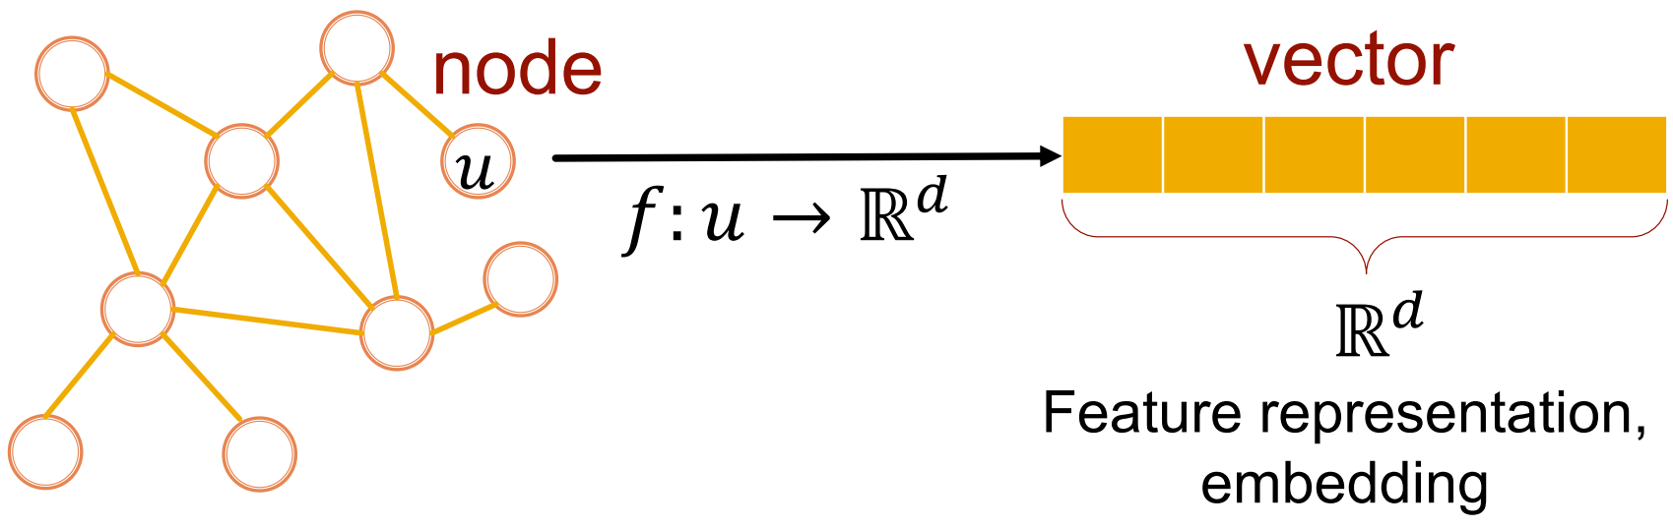
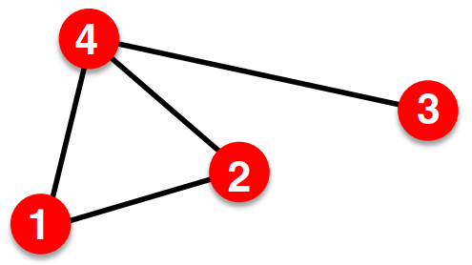
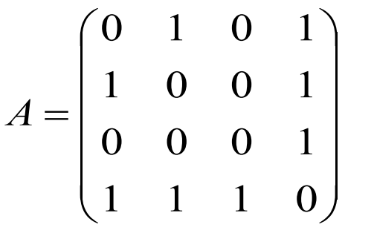
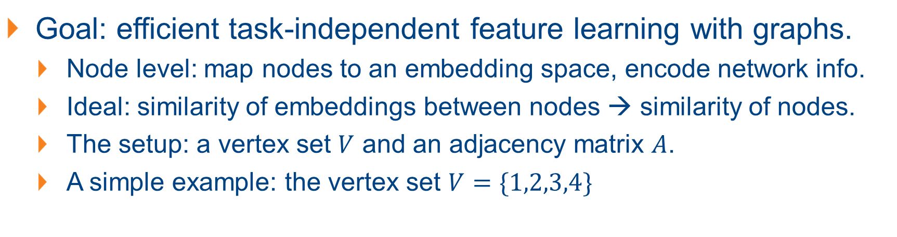
Graph Representation Learning
Goal: efficient task-independent feature learning with graphs.
Node level: map nodes to an embedding space, encode network info.
Ideal: similarity of embeddings between nodes → similarity of nodes.
The setup: a vertex set $V$ and an adjacency matrix $A$.
A simple example: the vertex set $V=\{1,2,3,4\}$
Notes:
Nodes that are close to each other should be connected by an edge.

Slide 13
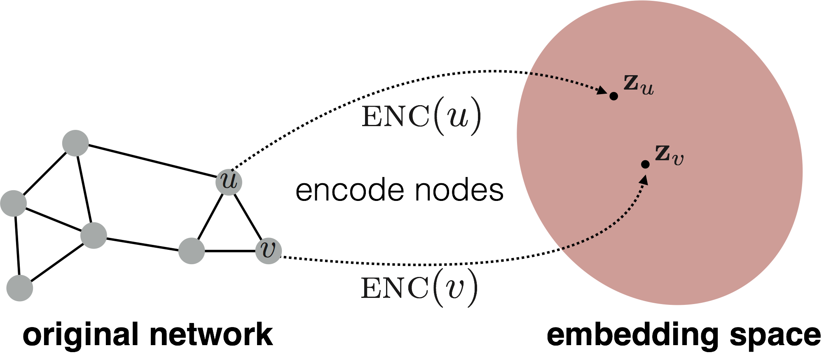
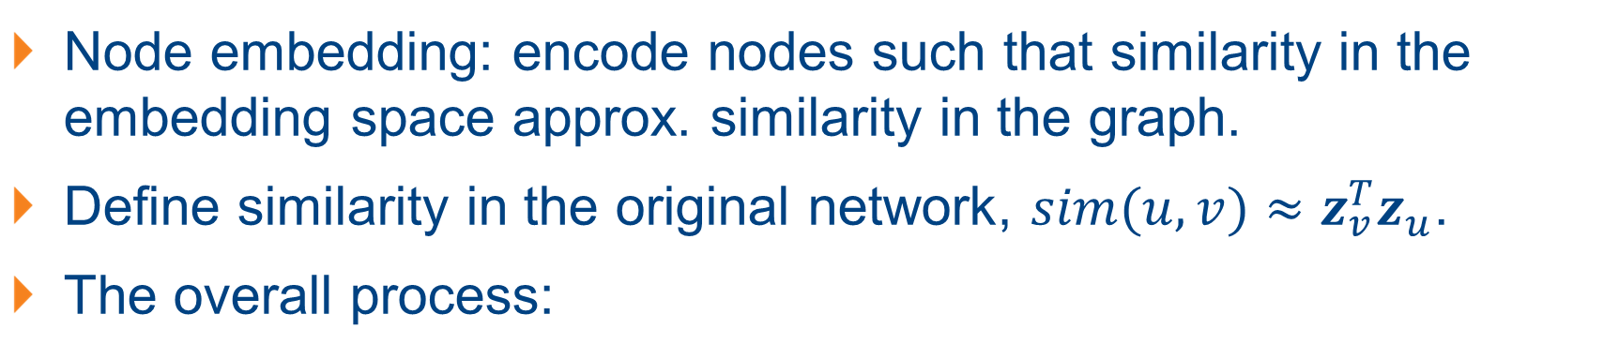
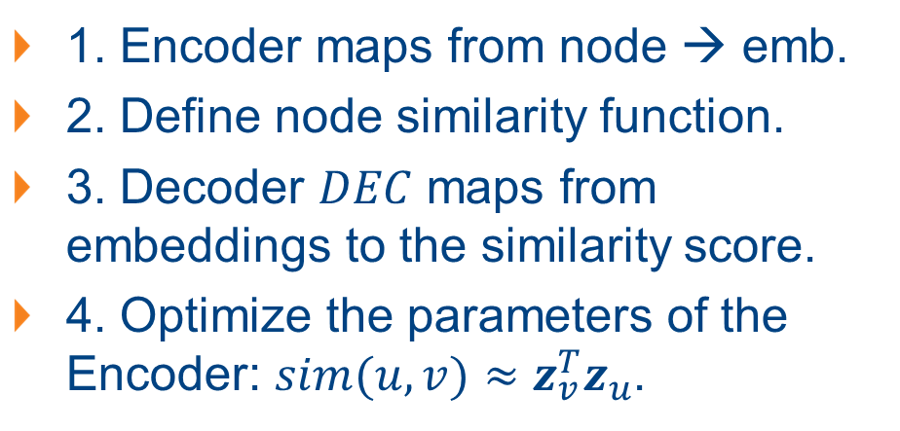
The Primary: Node Embedding
Node embedding: encode nodes such that similarity in the embedding space approx. similarity in the graph.
Define similarity in the original network, $sim(u,v)≈z_{v}^{T}z_{u}$.
The overall process:
1. Encoder maps from node → emb.
2. Define node similarity function.
3. Decoder $DEC$ maps from embeddings to the similarity score.
4. Optimize the parameters of the Encoder: $sim(u,v)≈z_{v}^{T}z_{u}$.

Slide 14
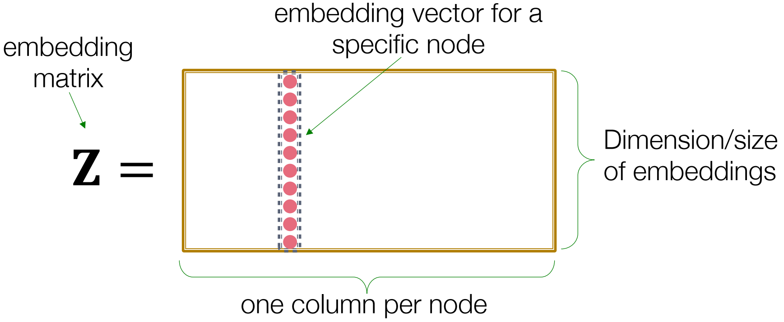
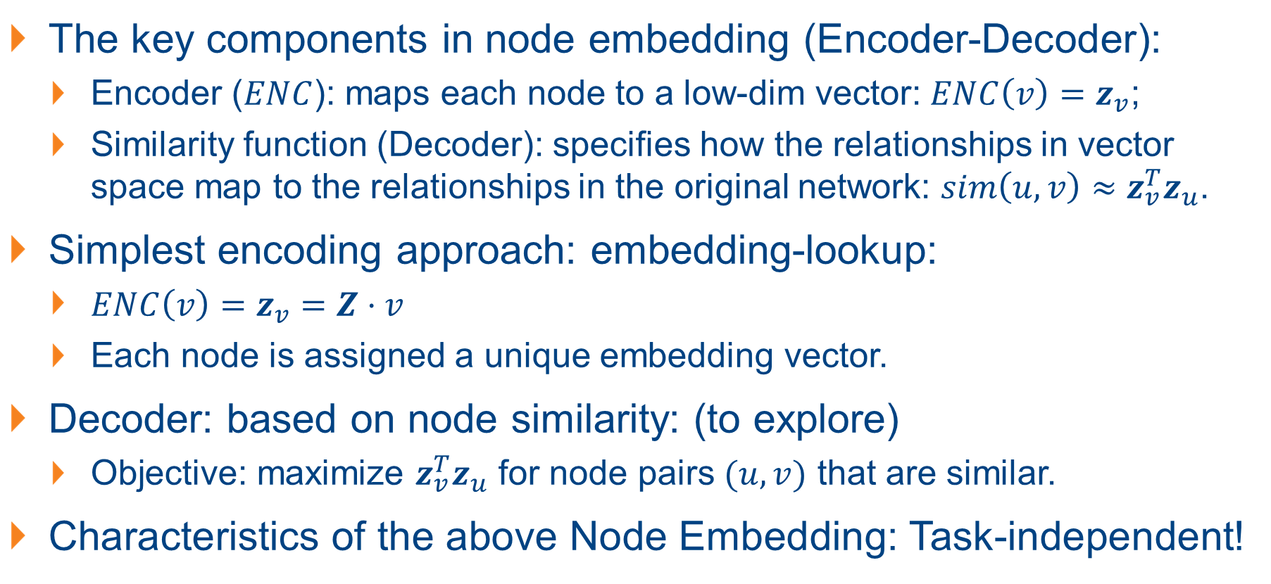
An Intuitive Way: Shallow Encoding
The key components in node embedding (Encoder-Decoder):
Encoder ($ENC$): maps each node to a low-dim vector: $ENC\left(v\right)=z_{v}$;
Similarity function (Decoder): specifies how the relationships in vector space map to the relationships in the original network: $sim\left(u,v\right)≈z_{v}^{T}z_{u}$.
Simplest encoding approach: embedding-lookup:
$ENC\left(v\right)=z_{v}=Z⋅v$
Each node is assigned a unique embedding vector.
Decoder: based on node similarity: (to explore)
Objective: maximize $z_{v}^{T}z_{u}$ for node pairs $(u,v)$ that are similar.
Characteristics of the above Node Embedding: Task-independent!

Slide 15
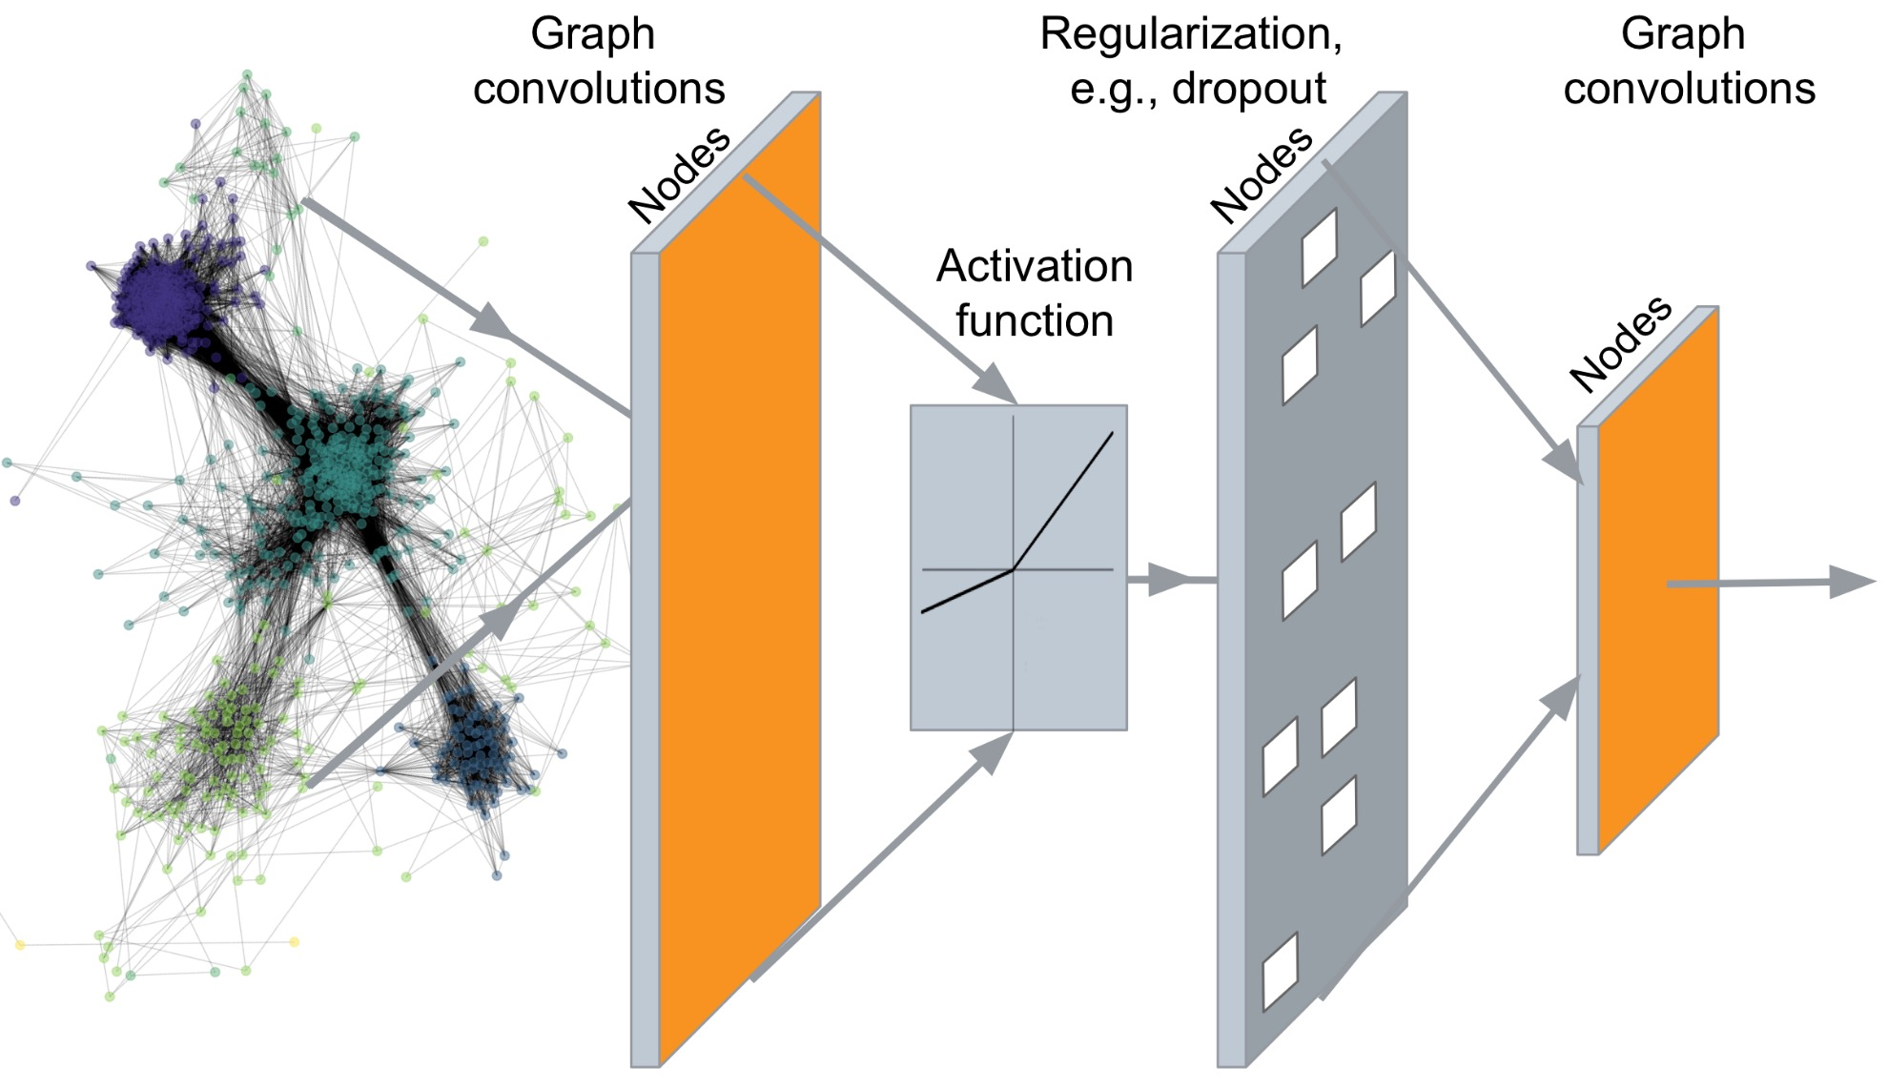
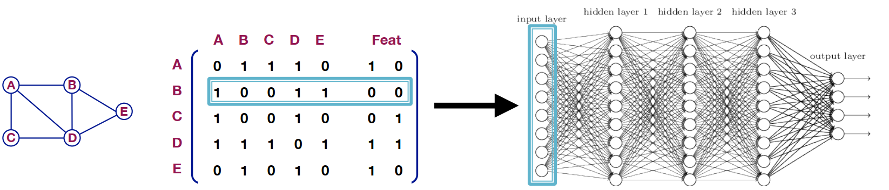
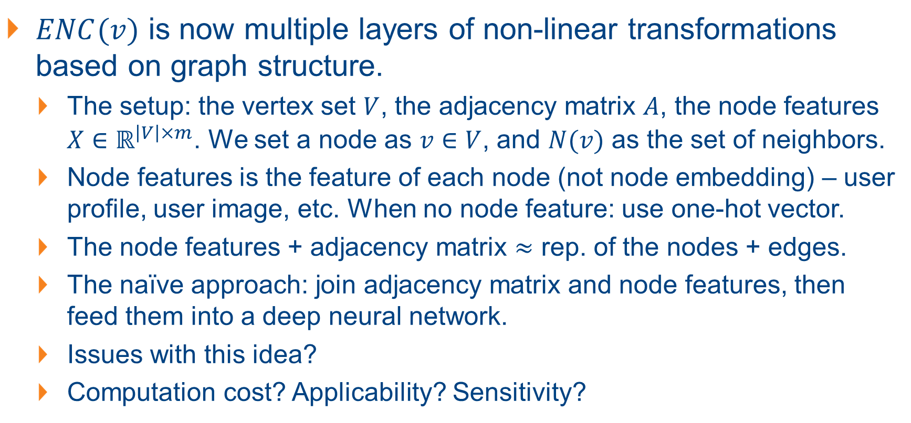
The Better Encoder: Deep Graph Encoders
$ENC(v)$ is now multiple layers of non-linear transformations based on graph structure.
The setup: the vertex set $V$, the adjacency matrix $A$, the node features $X∈ℝ^{\left|V\right|×m}$. We set a node as $v∈V$, and $N(v)$ as the set of neighbors.
Node features is the feature of each node (not node embedding) – user profile, user image, etc. When no node feature: use one-hot vector.
The node features + adjacency matrix $≈$ rep. of the nodes + edges.
The naïve approach: join adjacency matrix and node features, then feed them into a deep neural network.
Issues with this idea?
Computation cost? Applicability? Sensitivity?
Notes:
Computation cost: $O\left(V\right)$ parameters.
Applicability: not applicable to graphs of different sizes.
Sensitivity: sensitive to node ordering.

Slide 16
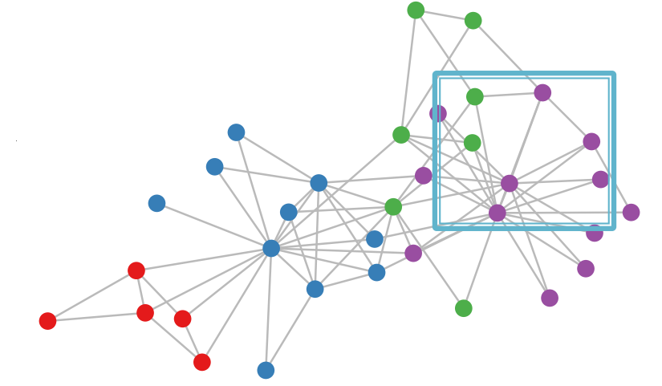
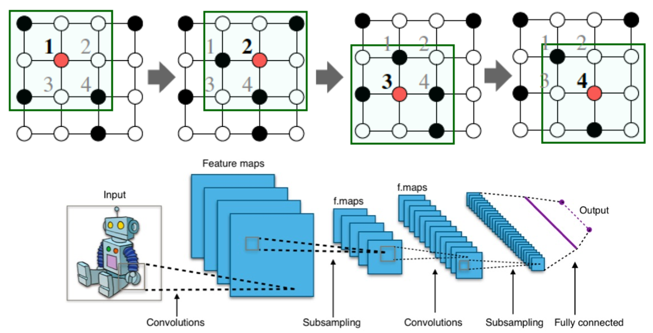
A Quick Recap: The CNN (on Images)
Images can be viewed as graphs, where the nodes are the different pixels, the edges are the links between the pixels.
How we deal with images? Convolutional Networks (CNN)
Can we also leverage CNN for the more general graphs?
Graphs vs. Images: the differences?
No fixed notion of locality or sliding window.
Graphs are permutation invariant.
What does it mean to be “permutation invariant”?

Slide 17
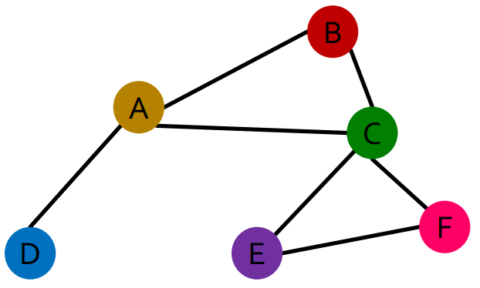
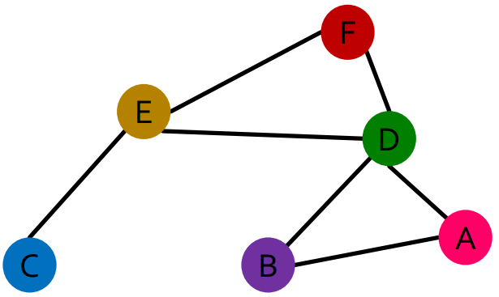
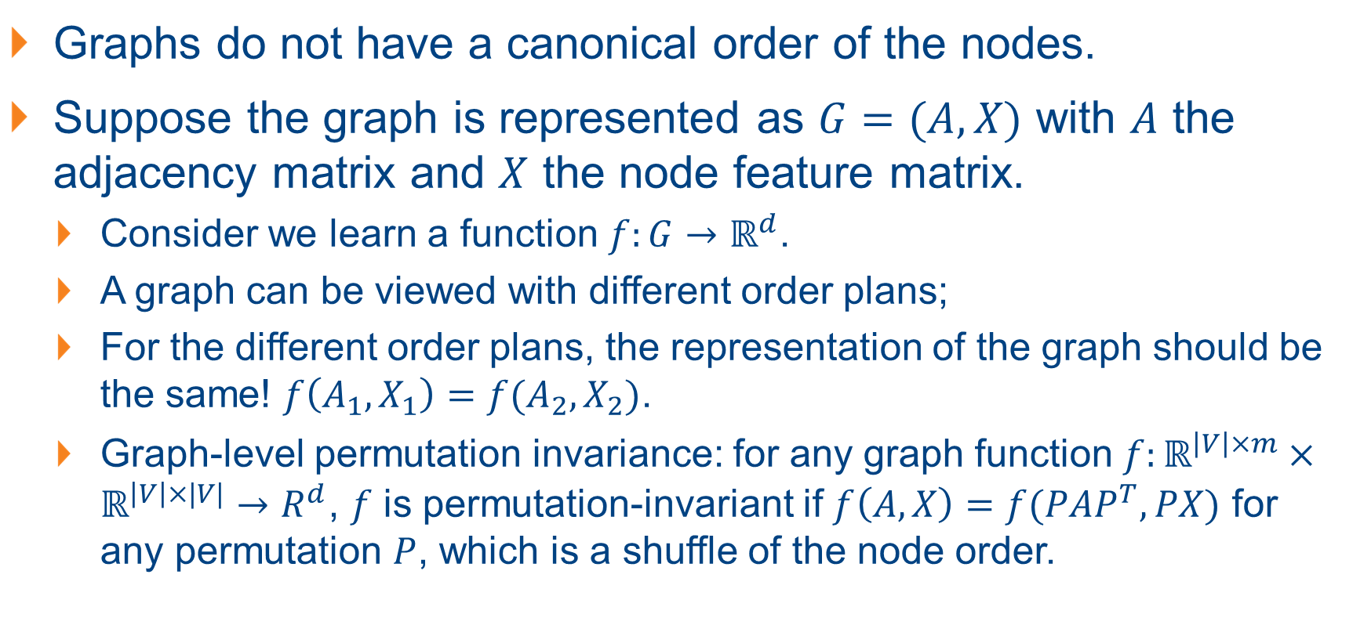
Charateristic of Graphs: Permutation Invariant
Graphs do not have a canonical order of the nodes.
Suppose the graph is represented as $G=(A,X)$ with $A$ the adjacency matrix and $X$ the node feature matrix.
Consider we learn a function $f:G→ℝ^{d}$.
A graph can be viewed with different order plans;
For the different order plans, the representation of the graph should be the same! $f\left(A_{1},X_{1}\right)=f(A_{2},X_{2})$.
Graph-level permutation invariance: for any graph function $f:ℝ^{\left|V\right|×m}×ℝ^{\left|V\right|×|V|}→R^{d}$, $f$ is permutation-invariant if $f\left(A,X\right)=f(PAP^{T},PX)$ for any permutation $P$, which is a shuffle of the node order.

Slide 18
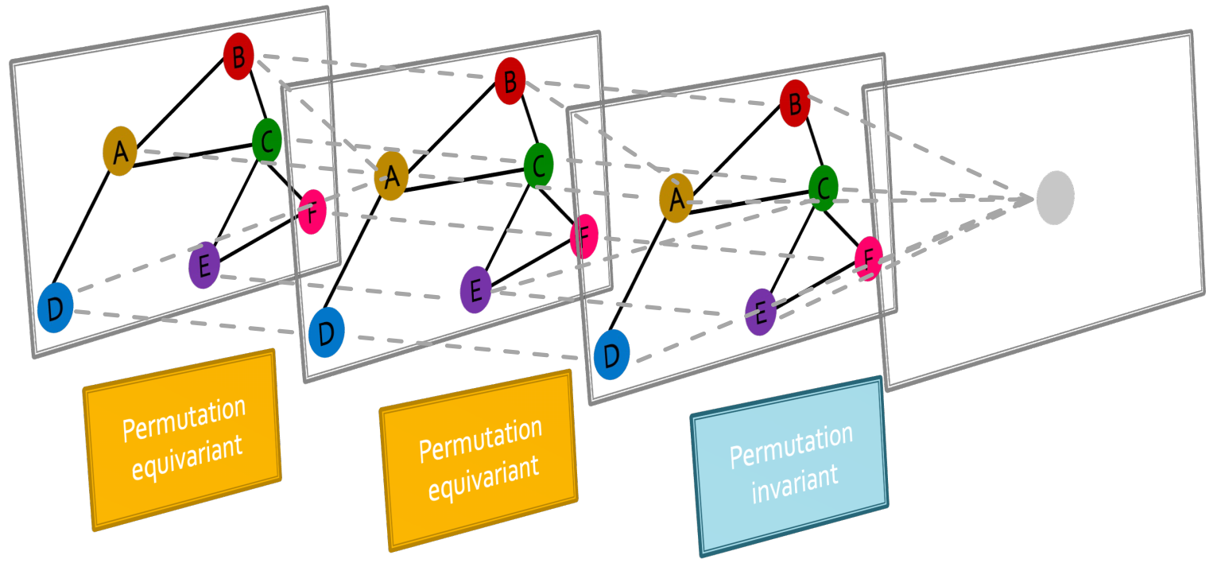
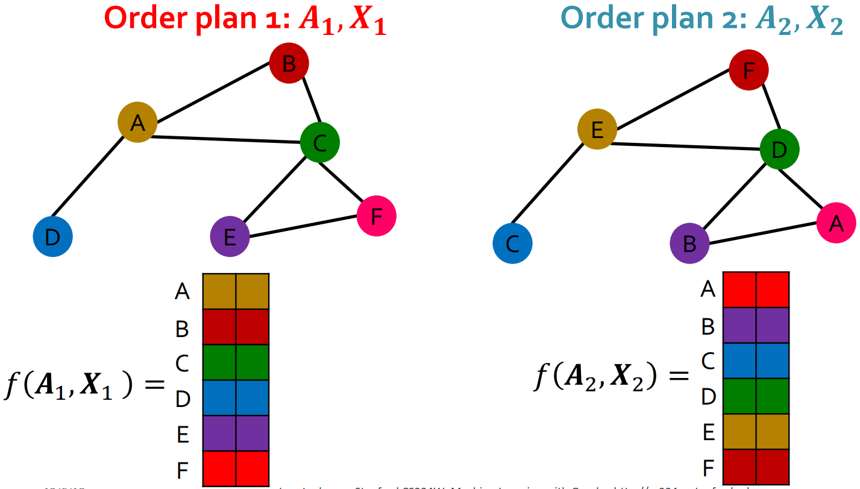
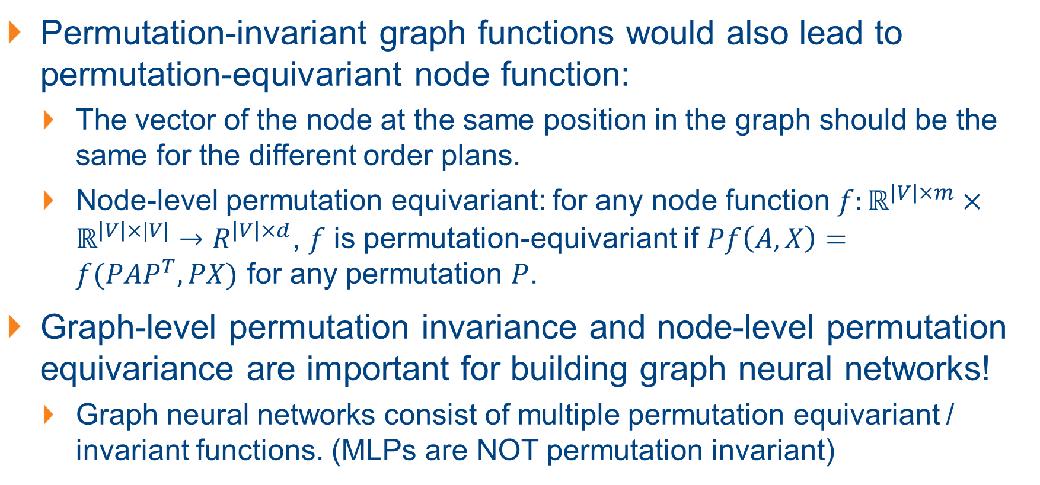
Charateristic of Nodes: Permutation Equivariant
Permutation-invariant graph functions would also lead to permutation-equivariant node function:
The vector of the node at the same position in the graph should be the same for the different order plans.
Node-level permutation equivariant: for any node function $f:ℝ^{\left|V\right|×m}×ℝ^{\left|V\right|×|V|}→R^{\left|V\right|×d}$, $f$ is permutation-equivariant if $Pf\left(A,X\right)=f(PAP^{T},PX)$ for any permutation $P$.
Graph-level permutation invariance and node-level permutation equivariance are important for building graph neural networks!
Graph neural networks consist of multiple permutation equivariant / invariant functions. (MLPs are NOT permutation invariant)

Slide 19
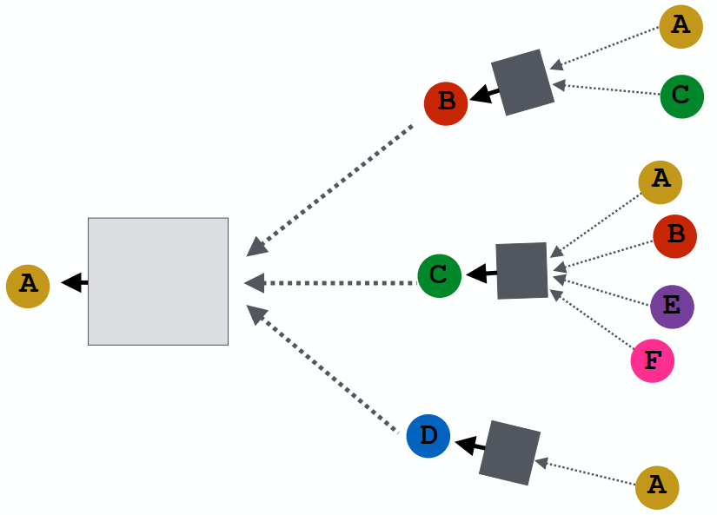
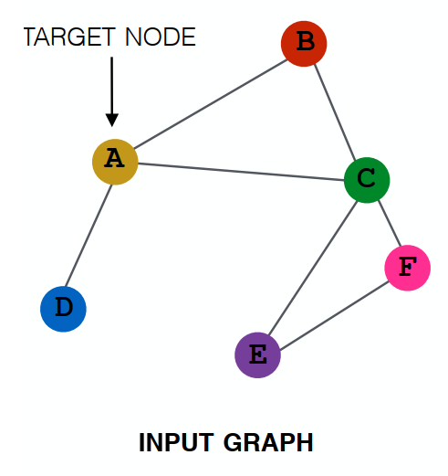
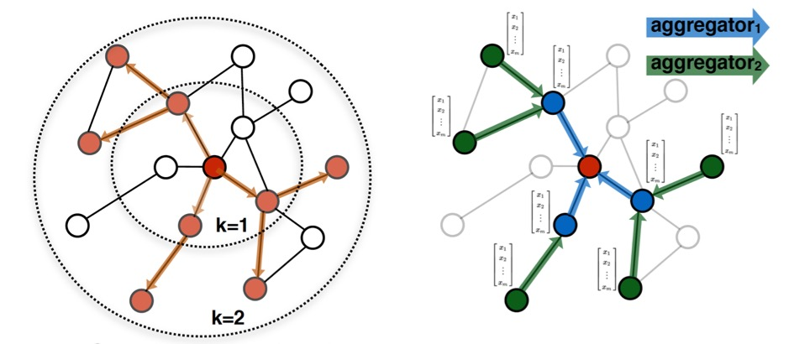
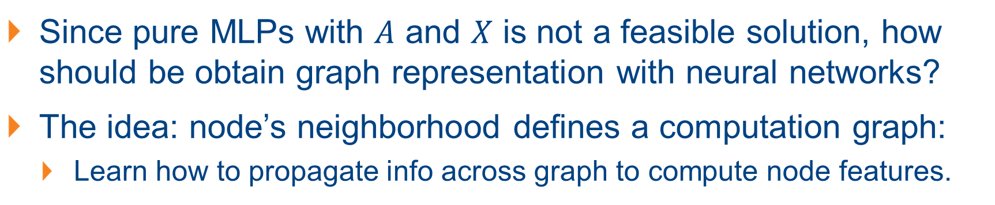
Graph Convolutional Networks: Aggregate Neighbors
Since pure MLPs with $A$ and $X$ is not a feasible solution, how should be obtain graph representation with neural networks?
The idea: node’s neighborhood defines a computation graph:
Learn how to propagate info across graph to compute node features.
The key: generate node embeddings based on the local network neighborhoods!

Slide 20
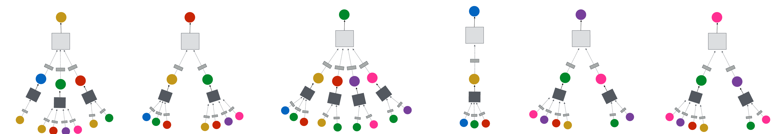
Graph Convolutional Networks
Generate node embeddings based on the local network neighborhoods.
Intuition 1: nodes aggregate information from their neighbors using neural networks.
Intuition 2: every node defines a computation graph based on its neighborhood.

Slide 21
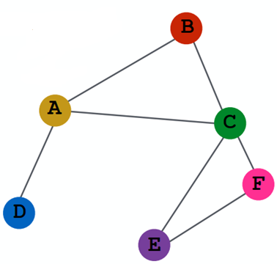
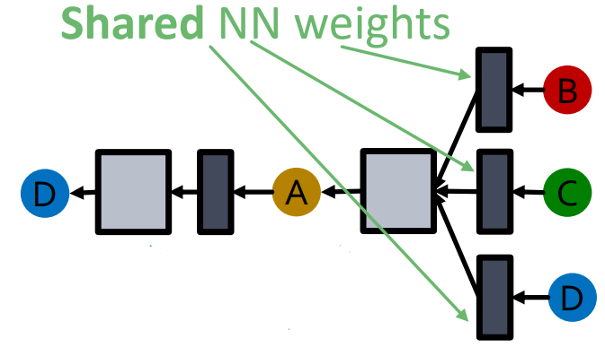

Building GCN with Neighborhood Aggregation
Basic approach: avg. information from neighbors and apply a neural network.
Given a node, the GCN that computes its embedding is permutation invariant.
Note that the average operation is permutation invariant.
Average from Neighbors
$$z_{A}$$
Apply Neural Network

Slide 22
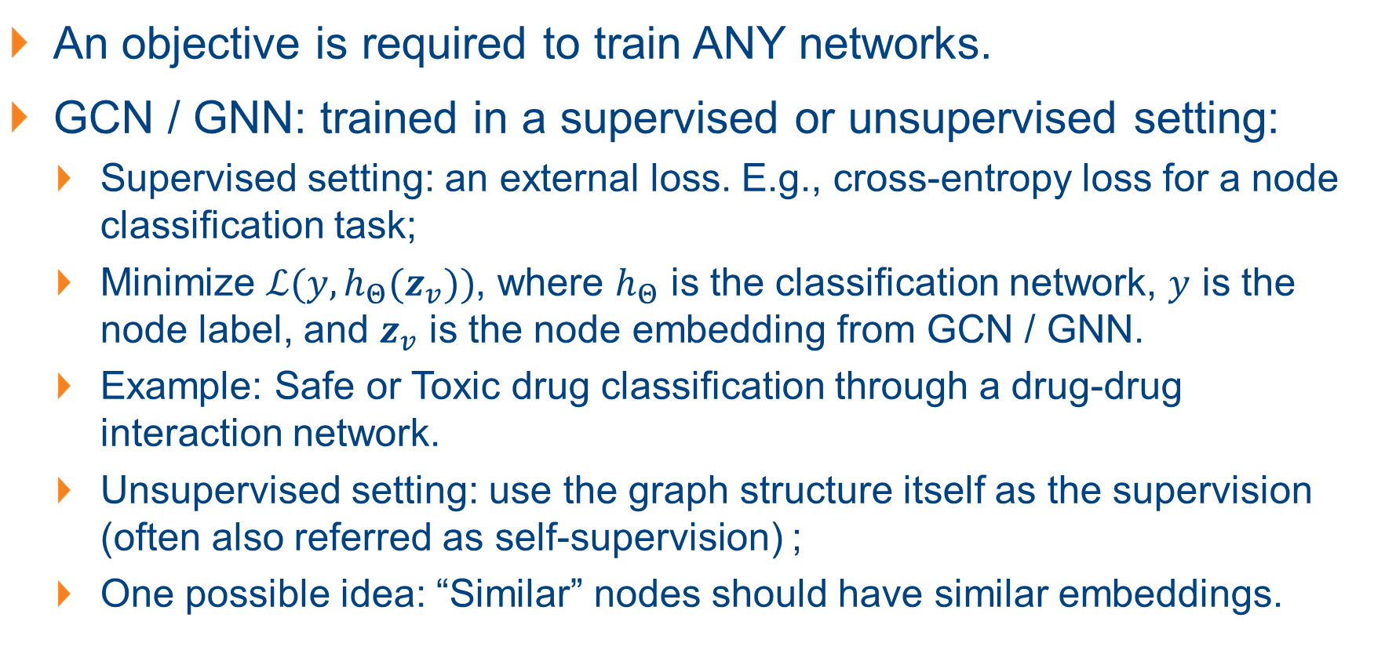
Training a GCN / GNN (Supervised / Unsupervised)
An objective is required to train ANY networks.
GCN / GNN: trained in a supervised or unsupervised setting:
Supervised setting: an external loss. E.g., cross-entropy loss for a node classification task;
Minimize $ℒ(y, h_{Θ}(z_{v}))$, where $h_{Θ}$ is the classification network, $y$ is the node label, and $z_{v}$ is the node embedding from GCN / GNN.
Example: Safe or Toxic drug classification through a drug-drug interaction network.
Unsupervised setting: use the graph structure itself as the supervision (often also referred as self-supervision) ;
One possible idea: “Similar” nodes should have similar embeddings.

Slide 23



GCN Model Design Overview
Define a neighborhood aggregation function
Define loss function on the embedding
$$z_{A}$$
Generate embeddings for new nodes (inference)
Train on a set of nodes, i.e., a batch of computation graphs.

Slide 24



Inductive Capability of GCNs
How are the trained GCNs applied for different graphs / nodes?
The same aggregation parameters are shared for all nodes!
The number of model params is sublinear in $|V|$ and we can generalize to unseen graphs / nodes.

Slide 25


GNNs / GCNs and CNNs
Recall for CNN: the output of CNN is also from a neighborhood.
We can learn different weights for different neighbors thanks to the use of fixed relative position of each pixel towards the center pixel.
CNN can be seen as a special GCN with fixed neighbohood size and ordering, with fixed size filters.
CNNs are not permutation invariant, while GNN / GCNs can process arbitrary graphs.

Slide 26



GNNs and Transformers
Transformers are based on self-attention:
Each word attends to all the other words.
Given vector values, a vector query, attention computes a weighted sum of the values dependent on the query.
Transformer layer can be viewed as a special GNN that runs on a fully connected word graph.
Notes:
Since each word attends to all the other words, the computation graph of a transformer layer is identical to that of a GNN on the fully-connected “word” graph.

Slide 27

Guest Lecture: Graph Representation Learning and Recent Trends
Dr. Luo Tianze (NTU)
Researcher, Alibaba-NTU Joint Research Institute
tianze002@e.ntu.edu.sg

Slide 28









Master in Computer Science
Artificial intelligence
B.Eng with First-Class Honours in Electrical & Electronics Engineering
AliExpress
Global recommender systems (Europe, Brazil, Russia)
Graph Representation Learning
Lazada SEA Recommender systems
2017
2019
2019
2020
M. Eng in Computer Sience & Algorithm Engineer
Algorithm Engineer
PhD in Computer Science
Notes:
Tianze Luo received the B.Eng. degree (Hons.) in electrical and electronics engineering from the Nanyang Technological University, Singapore, in 2017, his Masters degree in 2019, and his Ph. D degree in 2024, respectively. His Ph. D studies was under the supervision of Prof. Sinno Jialin Pan, and received scholarship from the prestigious Alibaba-NTU Talent programme. His research interests lies in the intersection of graph representation learning, multi-agent systems, deep reinforcement learning, and computer vision. His works have recently been published in Trans on Pattern Analysis and Machine Intelligence (TPAMI), ICLR, and WebConf WWW. He has also won the best paper award for the 2019 IEEE International Conference on Agents. He was a lecturer at SUSS in AI and Generative AI, and an algorithm engineer in Alibaba. He is currently a researcher in the Alibaba-NTU joint research institute.

Slide 29
Research Interest and Selected Publications
Research Interest: Graph representation learning; Graph Neural Networks; Graph Signal Processing; Graph Generation; Graph-based Recommender Systems; Graph Foundation Models.
Tianze Luo, Yong Liu, Sinno Jialin Pan. "Collaborative Sequential Recommendations via Multi-view GNN-Transformers". Accepted by ACM Transactions on Information Systems (ACM TOIS). (2024)
Zhanfeng Mo*, Tianze Luo* (co-first author), Sinno Jialin Pan. "Conditional Graph Generation with Graph Principal Flow Network". Accepted by ACM Web Conference (WWW). (2024)
Tianze Luo, Zhanfeng Mo, Sinno Jialin Pan. "Learning Adaptive Multiresolution Transforms via Meta-Framelet-based Graph Convolutional Network". Accepted by the International Conference on Learning Representations (ICLR). (2024)
Tianze Luo, Zhanfeng Mo, Sinno Jialin Pan. "Fast Graph Generation via Spectral Diffusion". Accepted by IEEE Transactions on Pattern Analysis and Machine Intelligence (IEEE TPAMI) (2023).
Tianbo Li*, Tianze Luo* (co-first author), Yiping Ke, Sinno Jialin Pan. "Mitigating Performance Saturation in Neural Marked Point Processes: Architectures and Loss Functions." Proceedings of the 27th ACM SIGKDD Conference on Knowledge Discovery & Data Mining. (2021)

